Slide 1
Variables, Expressions and Operators.
Week 1 | Lecture 2 (1.2)

Slide 2
This Week’s Content
Lecture 1.1
Introduction
Lecture 1.2
Variables, Expressions, and Operators
Chapters 1,2, and 3
Lecture 1.3
The Programming Process

Slide 3
Recap: What is Programming?
A way of telling a computer what to do.
A computer can’t infer (…yet).
Need to tell a computer every single step it needs to do in a language it can understand.
How would you request an egg for breakfast to a chef and to a computer/robot?
To a Chef
Sunny-side up, please!
To a Computer
“Turn on stove”
“Take out pan”
“Take one egg out of fridge”
“Crack egg”
“Pour egg into pan”
“Wait 5 minutes”

Slide 4


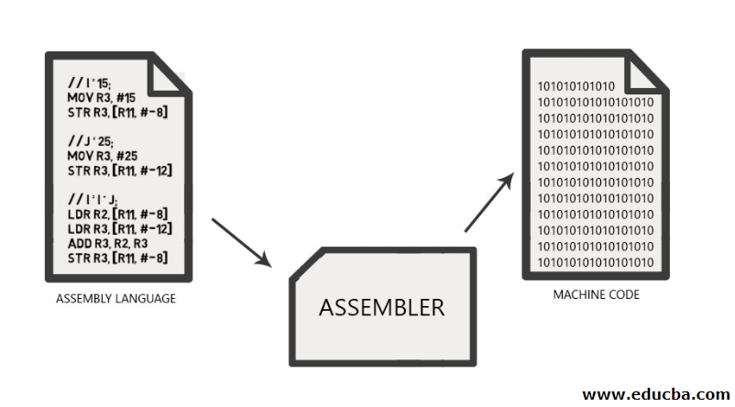
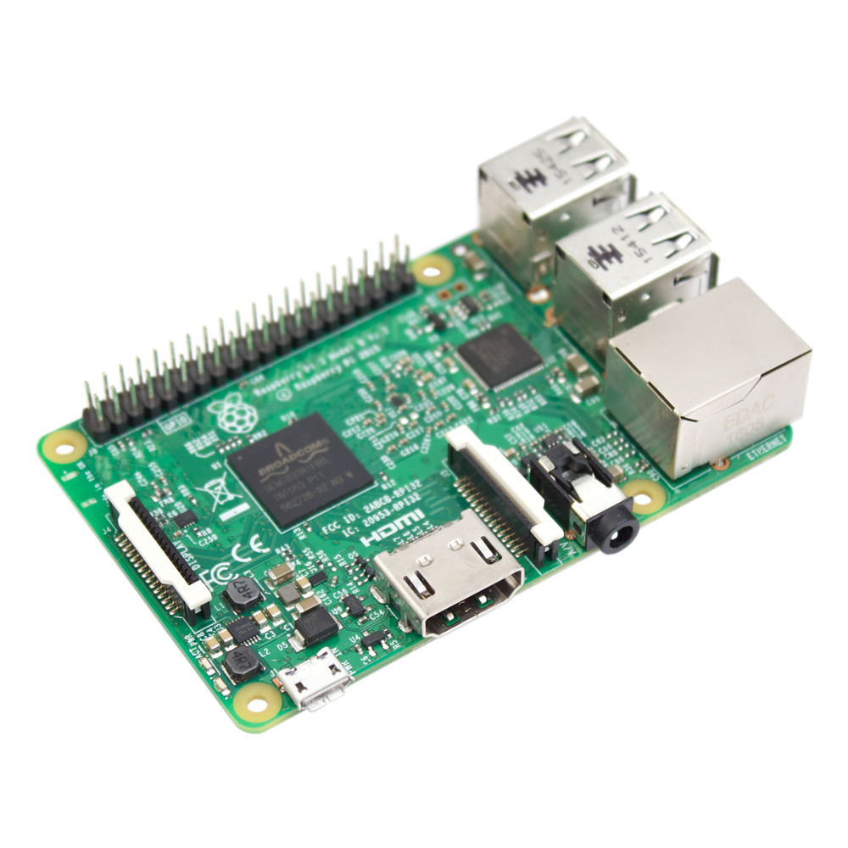
Programmer
How to Program a Computer.
English
Pseudocode
if x > 10:
print(“x is greater than 10”)
Programing Language
Compiler
Assembly Code
Assembler
Machine Code
Hardware

Slide 5
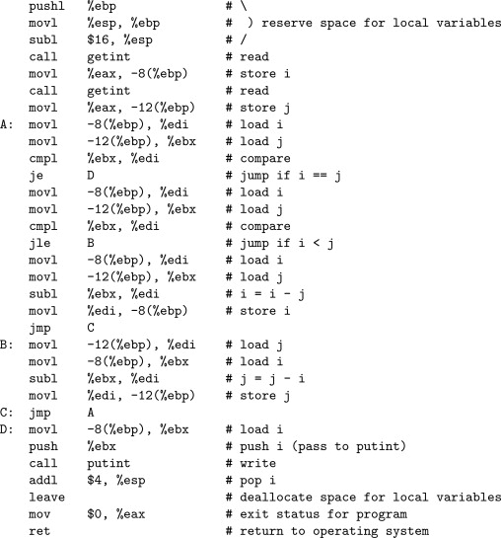
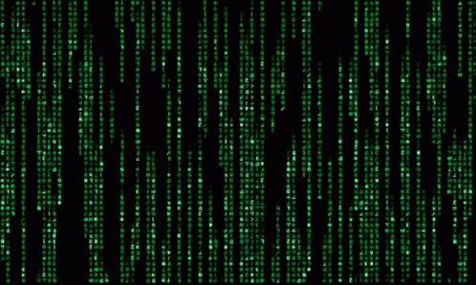
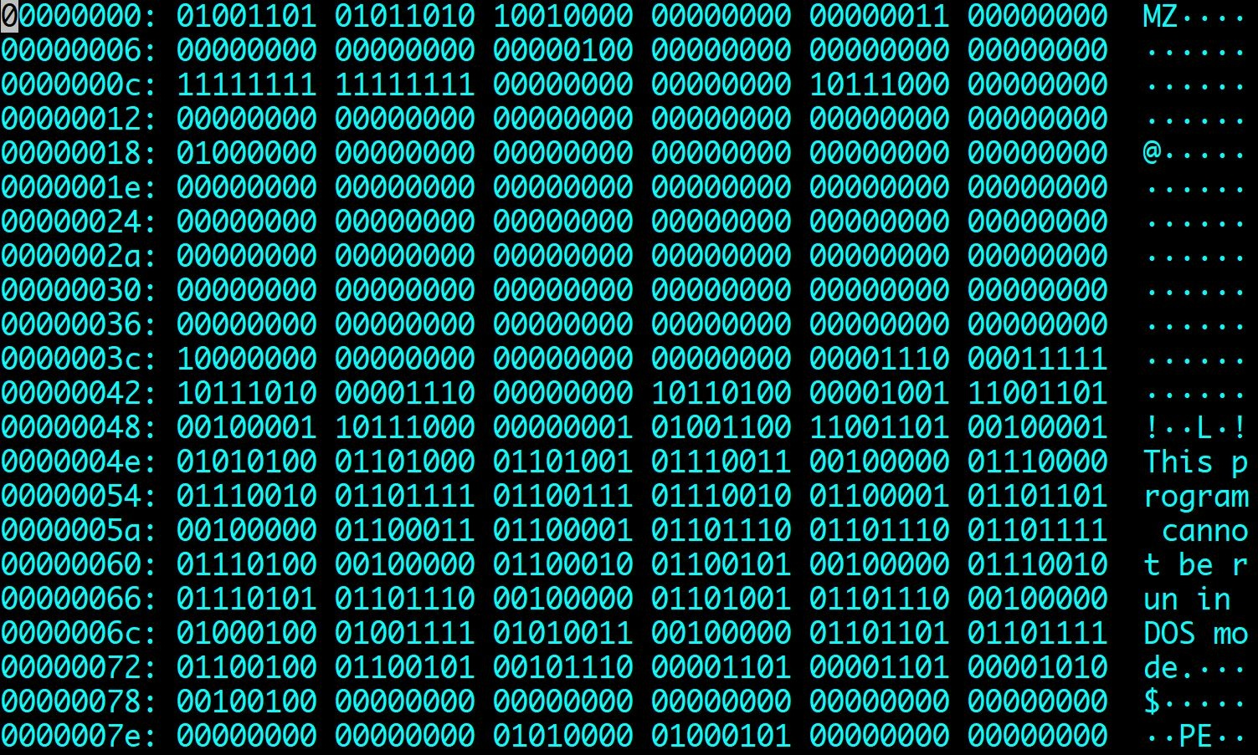
The power of programming languages
if x > 10:
print(”x is greater than 10”)

Slide 6
Introducing Python
No end-of-instruction separators, such as semicolons (like in C or Java)
Programs are stored in .py files
Comments start with a # character
Whitespace matters (exactly 4 spaces means indentation)
Python is an interpreted language (not a compiled one)
You can run code one statement at a time, just like a calculator or Matlab
This means variables can change type during runtime, and do not have to be declared before running

Slide 7
Arithmetic Operators
Operator
Operation
Expression
English description
Result
+ | addition | 11 | + | 56 | 11 plus 56 | 67
- | subtraction | 23 | - | 52 | 23 minus 52 | -29
* | multiplication | 4 | * 5 |  | 4 multiplied by 5 | 20
** | exponentiation | 2 | ** | 5 | 2 to the power of 5 | 32
/ | division | 9 | / 2 |  | 9 divided by 2 | 4.5
// | integer division | 9 | // | 2 | 9 divided by 2 | 4
% | modulo (remainder) | 9 | % 2 |  | 9 mod 2 | 1

Slide 8
Arithmetic Operator Precedence
When multiple operators are combined in a single expression, the operations are evaluated in order of precedence (from left to right)
Operator
Precedence
**
highest
- (negation)
*, /, //, %
+ (addition), - (subtraction)
lowest

Slide 9
Using Python as a Calculator
Let’s start with a simple use of Python to get the feel for our new environment
Don’t forget your BEDMAS (or PEMDAS)!
Open your notebook
Click Link:
1. Using Python as a Calculator

Slide 10
Variables and Memory
The most basic thing you can do in a computer program is to assign a value to a variable.
Assignment statements
x = 20
(or)
y = 20+5*2
Rules for assignment
1. Evaluate the expression to the right of = sign (produces memory address of the value)
2. Store the memory address in the variable on the left of the = sign
variable = expression

Slide 11
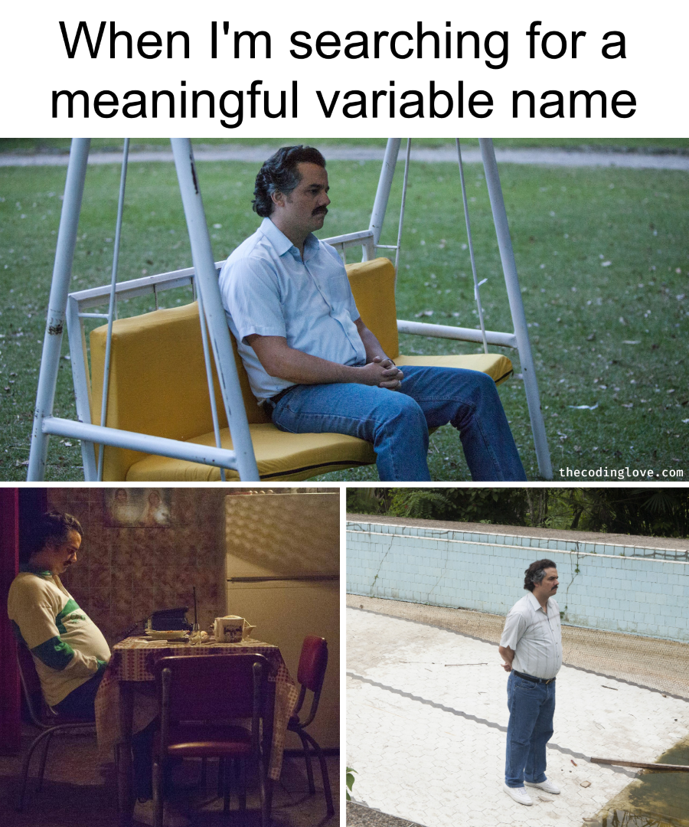
Variable Names and Conventions
The rules for legal Python names:
Names must start with a letter or _ (underscore)
Names must contain only letters, digits, and _
In most situations, the convention is to use pothole_case
Lowercase letters with words separated by _ to improve readability
Try to add meaning where possible!
Ex: gas_mileage and cost_per_litre instead of nomnom and nomnomnom
Save yourself when debugging & put your TAs in a good mood when marking

Slide 12
Memory Visualization Example
>>> difference = 20
>>> double = 2 * difference
>>> double
40
>>> difference = 5
>>> double
40

Slide 13
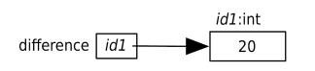
Memory Visualization Example
>>> difference = 20
>>> double = 2 * difference
>>> double
40
>>> difference = 5
>>> double
40
Evaluate the expression on the right of the = sign -> 20.
This produces the value 20, which we’ll put at memory address id1.
Make the variable on the left of the = sign, difference, refer to 20 by storing id1 in difference.

Slide 14
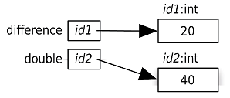
Memory Visualization Example
>>> difference = 20
>>> double = 2 * difference
>>> double
40
>>> difference = 5
>>> double
40
Evaluate the expression on the right of the = sign: 2 * difference. As we see in the memory model, difference refers to the value 20, so this expression is equivalent to 2 *20, which produces 40. We’ll pick the memory address id2 for the value 40.
Make the variable on the left of the = sign, double, refer to 40 by storing id2 in double.

Slide 15
Memory Visualization Example
>>> difference = 20
>>> double = 2 * difference
>>> double
40
>>> difference = 5
>>> double
40
When Python executes the third statement, double, it merely looks up the value that double refers to (40) and displays it.

Slide 16
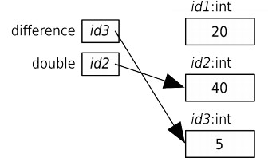
Memory Visualization Example
>>> difference = 20
>>> double = 2 * difference
>>> double
40
>>> difference = 5
>>> double
40
Evaluate the expression on the right of the = sign: 5. This produces the value 5, which we’ll put at the memory address id3.
Make the variable on the left of the = sign, difference, refer to 5 by storing id3 in difference.

Slide 17
Memory Visualization Example
>>> difference = 20
>>> double = 2 * difference
>>> double
40
>>> difference = 5
>>> double
40
Variable double still contains id2, so it still refers to 40. Neither variable refers to 20 anymore which is OK as Python will take care of recycling of memory when it is no longer used.

Slide 18
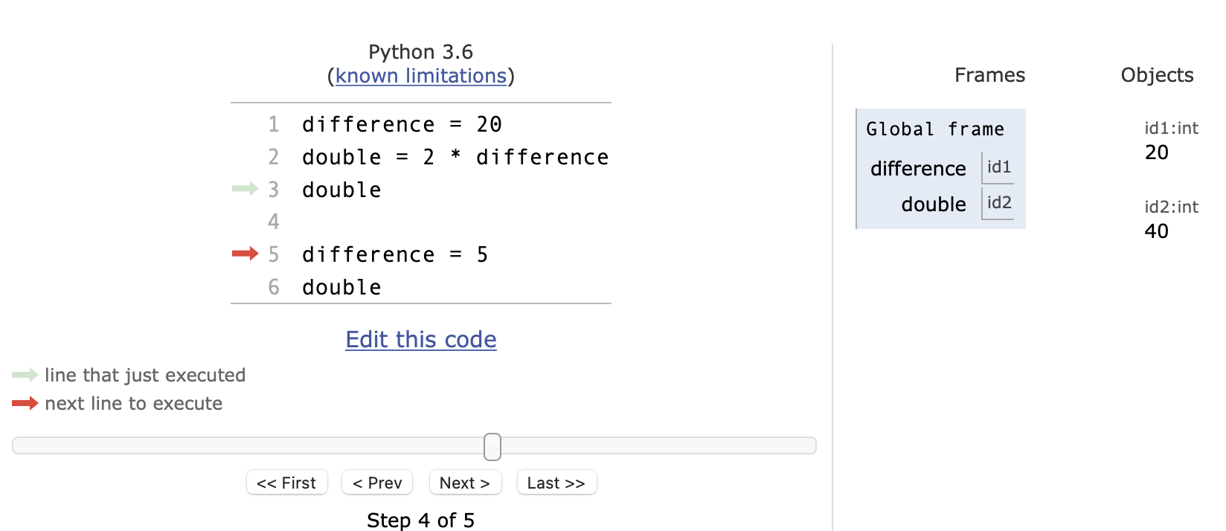
Python Tutor Visualization
http://pythontutor.com/visualize.html
Code might seem simple now…

Slide 19
Variables and Memory
Let’s go experiment with some of what we just saw
Assignment statements
Declaring variables
Different variable names
Memory locations
(and the famous print statement!)
Open your notebook
Click Link:
2. Variables and Memory

Slide 20
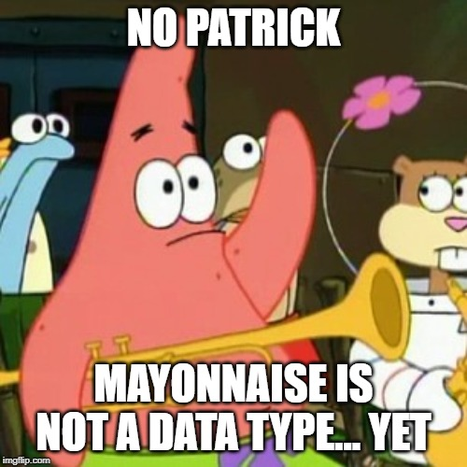
Variable Types
A type is a set of values and the operations that can be performed on those values.
int: integer
ex. 3, 4, 894, 0, -3, -18
float: floating point number
ex. -5.6, 7.342, 53452.0, -89.34

Slide 21
Numerical Type Examples
>>> 5 + 2 * 4
>>> 5.0 + 2 * 4
>>> 30/6
>>> 30//6

Slide 22
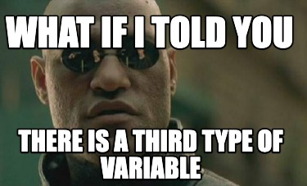
Type: str (pronounced string)
str: string literal is a sequence of characters
Start and end with single quotes (') or double quotes (")
ex. 'hello', "What is 10 * (2 + 9)?”
Just like writing in English, the quote type must match (i.e. 2 singles or 2 doubles, not 1 of each)

Slide 23
String Type Examples
>>> ‘how are you?’
>>> ”short- and long-term”
>>> ‘”APS106” is already my favourite course’
>>> “APS106 stinks’
SyntaxError

Slide 24
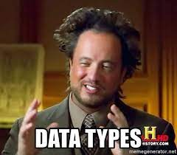
More data types?!
You can get the data type of any object by using the type() function
>>> x = 5
>>> print(type(x))
<class ‘int’>
Other Python data types:
List
Tuple
Dictionary
Set
Boolean
BUT we will worry about these later…

Slide 25
Variables Types
Let’s go experiment with some of what we just saw
“int”s vs “float”s
The ”str” type
Using types and variables in expressions
Combining our type knowledge with some arithmetic operations
Open your notebook
Click Link:
3. Different Types of Variables

Slide 26
Augmented Assignment Operations
Operator | Expression | Identical Expression | English description
+= | x = 7 x += 2 | x = 7 x = x + 2 | x refers to 9
-= | x = 7 x -= 2 | x = 7 x = x - 2 | x refers to 5
*= | x = 7 x *= 2 | x = 7 x = x * 2 | x refers to 14
/= | x = 7 x /= 2 | x = 7 x = x / 2 | x refers to 3.5
//= | x = 7 x //= 2 | x = 7 x = x // 2 | x refers to 3
%= | x = 7 x %= 2 | x = 7 x = x % 2 | x refers to 1
**= | x = 7 x **= 2 | x = 7 x = x ** 2 | x refers to 49
Open your notebook
Click Link:
4. Augmented Assignment Operators

Slide 27
Let’s Code! Convert gas mileage from American to Canadian
In the old days (and still in the United States), the mileage of a gas-powered car was measured in miles per gallon.
Now for places that use the metric system, we prefer to measure “mileage” as “fuel consumption” in litres per hundred kilometres.
Write code to do the conversion to metric given a value in miles per gallon.
Open your notebook
Click Link:
5. Let’s Code!

Slide 28
Variables, Expressions and Operators.
Week 1 | Lecture 2 (1.2)

